Slide 1
Renewable Energy Sources

Slide 2
Renewable Energy Sources
Lecture Question
  What are the renewable energy sources? Make a list, as comprehensive as possible.
  What are the environmental impacts of these energy sources?
  Renewable Energy Sources
    Radiant solar energy
      Solar heating (passive and active), solar power plants, photovoltaic cells
    Biomass energy
      Direct: combustion of biomass
      Indirect: chemical conversion to biofuel
    Wind energy
    Hydro energy
    Geothermal energy
      Power plants, direct use, heat pumps
    Ocean energy
      Tidal; salinity-driven

Slide 3
Hydro Energy
Advantages
  Cheap to operate
    Long life and lower operating costs than all other power plants
  Renewable
  High yield
    Lower energy cost than any other method
  Pretty plentiful
    Some countries depend almost entirely on it
  Not intermittent (if reservoir is large enough)
  Reservoirs have multiple uses
    Flood control, drinking water, aquaculture, recreation
  Less air pollution than fossil fuel combustion

Slide 4
Hydro Energy
Disadvantages:
  Human population displacement
  More significant breeding ground for disease
  Reduces availability of water downstream
  Ecosystem impacts
    Barriers to migrating fish
    Loss of biodiversity both upstream and downstream
    Coastal erosion
    Reduces nutrient flow (dissolved and particulate)
  Water pollution problems
    Low dissolved oxygen (DO)
    Increased H₂S toxicity; other DO-related problems
    Siltation a big problem (also shortens dam life)
  Air pollution
    Actually may be a significant source of GHGs (CH₄, N₂O, CO₂)
  Decommissioning is a big problem
The Size Issue
  Many (most) of the above problems are significantly worse for larger dams
  However, small dams have shorter lifetimes, less capacity, and are more intermittent

Slide 5
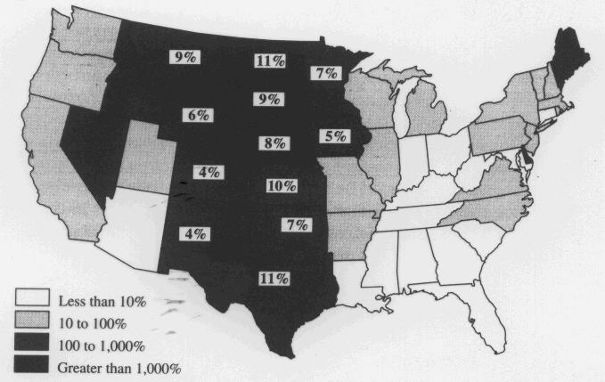
Wind Energy
How it works
  Wind turbines directly generate electricity
  Quite efficient (not a heat engine)
Wind Energy Potential
shading gives potential for in-state electrical needs
numbers give total potential for total US needs

Slide 6
Wind Energy
Advantages
  High net energy yield
  Renewable and free
  Very clean source of energy
    No pollution (air or water) during operation
  Long operating life
  Low operating/maintenance costs
  Can be quickly built; not too expensive
  Now almost competitive with hydro and fossil fuels
  Land can be used for other purposes
    Can combine wind and agricultural farms

Slide 7
Wind Energy
Disadvantages
  Energy storage issues
    An intermittent source of energy; need backup (eg stored energy) for low-wind days
    Or must be connected to the electrical grid
  Only practical in areas that are windy enough
  Visual pollution
  Danger to birds
    New (slow turning) designs largely eliminate this problem
  Low energy density of wind
    Must use large areas of land

Slide 8
Biomass Energy
What is it?
  Biomass energy is the use of living and recently dead biological material as an energy source
  Ultimately dependent on the capture of solar energy and conversion to a chemical (carbohydrate) fuel
  Theoretically it is a carbon neutral and renewable source of energy
How it works?
  Traditional: forest management, using wood as fuel
  Use of biodegradable waste
    Examples: manure, crop residue, sewage, municipal solid waste
  Recent interest in agricultural production of energy crops
    Should be high yield and low maintenance
    Examples: corn, sugarcane, switchgrass, hemp, willow, palm oil, rapeseed, and many others
    Does not have to be a food crop
    Recent interest in bioengineered (GM) plants as fuel sources
  Production of a liquid or gaseous biofuel
    Biogas due to the breakdown of biomass in the absence of O₂
      Includes capture of landfill methane
    Bioethanol from fermentation, often from corn. Cellulosic bioethanol is usually from a grass (switchgrass)
    Biodiesel from rapeseed and other sources

Slide 9
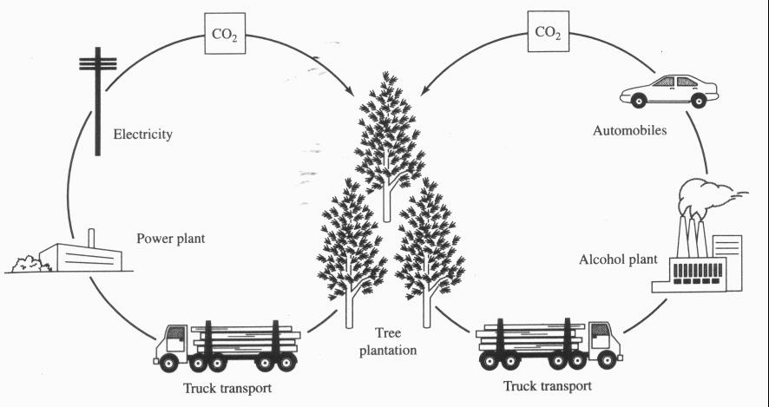
Biomass Energy
Carbon neutral
  CO₂ ultimately released in energy generation is recently captured and so ideally does not change total atmospheric levels
  Carbon leaks can result in a net increase in CO₂ levels
  Sequestration in soil can result in a net decrease in CO₂ levels

Slide 10
Biomass Energy
Advantages
  Versatile
  Renewable
  No net CO₂ emissions (ideally)
  Emits less SO₂ and NO_{x} than fossil fuels
Disadvantages
  Low energy density/yield
    In some cases (eg, corn-derived bioethanol) may yield no net energy
  Land conversion
    Biodiversity loss
    Possible decrease in agricultural food productivity
  Usual problems associated with intensive agriculture
    Nutrient pollution
    Soil depletion
    Soil erosion
    Other water pollution problems

Slide 11
Geothermal Energy
How it works
  Geothermal power plants
    Use earth’s heat to power steam turbines
  Geothermal direct use
    Use hot springs (etc) as heat source
  Geothermal heat pumps
Advantages
  Renewable
  Easy to exploit in some cases
  CO₂ production less than with fossil fuels
  High net energy yield
Disadvantages
  Not available everywhere
  H₂S pollution
  Produces some water pollution (somewhat similar to mining)

Slide 12
Radiant Solar Energy
How it works
  Solar power plants
    Steam produced to turn turbine
  Solar heating
    Active and passive systems
  Photovoltaic cells
    “Solar batteries” use special semiconductors
Advantages
  Renewable and free
  High energy yield
  A very clean source of energy
    No air/water pollution during operation
  Low operating costs
    Will pay for themselves over time
Disadvantages
  Intermittent source
    Energy storage issues
  Low energy density
    Requires pretty much land

Slide 13
The Hydrogen Economy
Lecture Questions
  What is the hydrogen economy?
  Explain how the hydrogen economy could potentially serve as the basis for a renewable energy system that emits little or no air pollution
Definition
  The Hydrogen Economy is a hypothetical large-scale system in which elemental hydrogen (H₂) is the primary form of energy storage
    Fuel cells would be the primary method of conversion of hydrogen to electrical energy.
      Efficient and clean; scalable
    In particular, hydrogen (usually) plays a central role in transportation.
Potential Advantages
  Clean, renewable
  Potentially more reliable (using distributed generation)
BUT many roadblocks including potential showstoppers
  Poses great technological challenges for efficient hydrogen production, storage, and transport

Slide 14
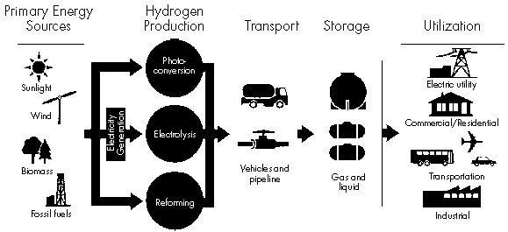
Components of the Hydrogen Economy
Infrastructure needs
  Production
  Storage
  Delivery
  End use

Slide 15
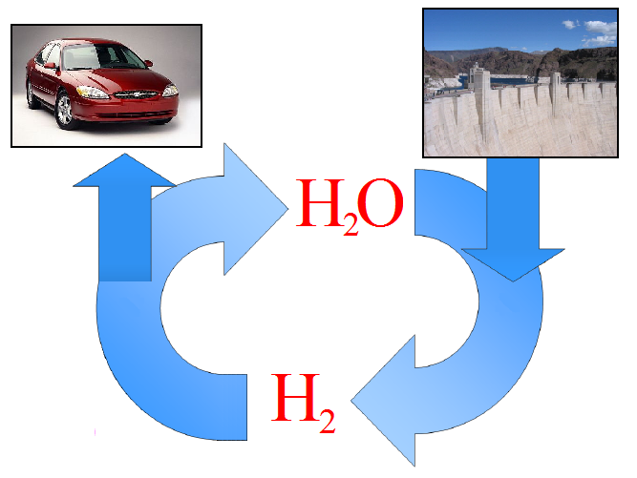
Hydrogen as a Transportation Fuel

Slide 16
Hydrogen Production
Fossil Fuels
  Steam Reforming of Natural Gas
    Combination of methane and steam produces hydrogen gas
      Carbon monoxide is also produced
      The “water gas shift” reaction can produce further hydrogen from the carbon monoxide. Carbon dioxide is produced too.
    Most economical; main current method
      Carbon sequestration one method to reduce CO₂ emission
  Partial Oxidation (POX) of Hydrocarbons
    HC partially oxidized to produce hydrogen and carbon monoxide
  Coal Gasification
    Gasified at high temps, then processed
    Can also be used to get hydrogen from biomass

Slide 17
Hydrogen Production
Electrolysis
  Efficiencies 70-85%
  Produces highest purity of hydrogen
  Currently, the electricity consumed is usually worth more than the hydrogen produced
Experimental methods
  Biological hydrogen production
  Direct photolysis
  Thermolysis

Slide 18
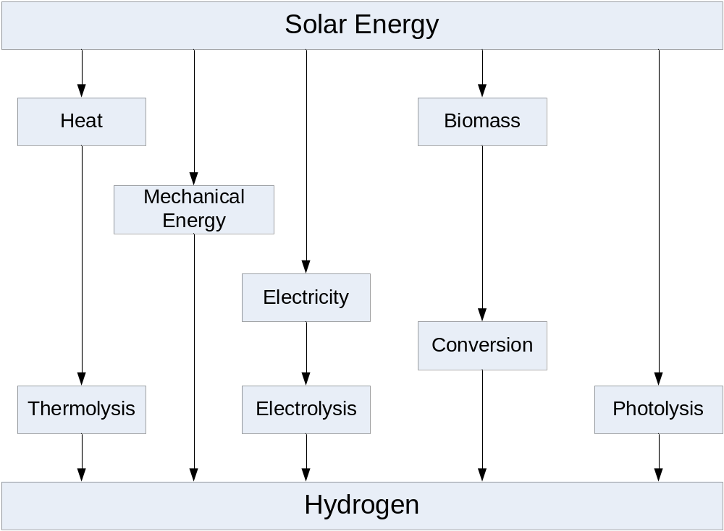
Renewable Solar Paths to Hydrogen

Slide 19
Hydrogen Storage
Large-Scale Stationary Storage
  Underground in depleted oil/gas fields, aquifers, caverns
Intermediate- and Small-Scale Stationary/Mobile Storage
  The focus of most current research
  As a liquid
    Advantage: higher energy density, cheaper transport
    Disadvantage: economic/energy cost of liquefaction is significant
  As a compressed gas
    Probably best short-term method, particularly with advanced materials to decrease weight
    Advantages
      Rapid charging/discharging
      Lower costs than liquid storage
    Disadvantages:
      Low energy density, Probably still acceptable for motor vehicles
      Safety (esp public perception)
  Metal hydrides
    Hydrogen is absorbed under pressure, released when heated
    Less filling pressure needed
    Low energy density, long recharge time, expensive
Experimental Methods
  Improved hydrides; carbon nanotubes; many other materials (eg conversion to ammonia)

Slide 20
Chemical Batteries
Lecture Questions
  What are batteries and how do they work?
  What’s the difference between a “regular” and a “rechargeable” battery? Why are rechargeable batteries sometimes referred to as “storage” batteries?
  Chemical batteries are based on reduction-oxidation (redox) reactions, which are reactions where electron transfer occurs.
    The oxidation half-reaction occurs at the anode
    Electrons flow from the anode, through an external circuit, and to the cathode, where the reduction half-reaction occurs
  Chemical batteries are a very efficient method of generating electricity
    Efficiencies of 80% are regularly achieved
    Significantly (2-3 times) more efficient than heat engines
  Rechargeable batteries can be hooked up to an external source of electricity to regenerate the redox reactants through electrolysis.
    Rechargeable batteries thus provide a means of storing electricity in chemical form. They are thus sometimes called storage batteries.

Slide 21
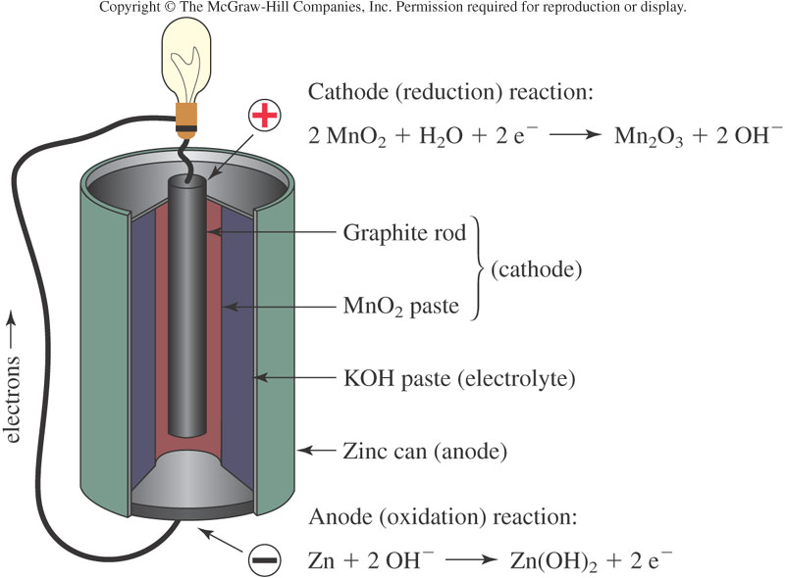
The Alkaline Battery

Slide 22
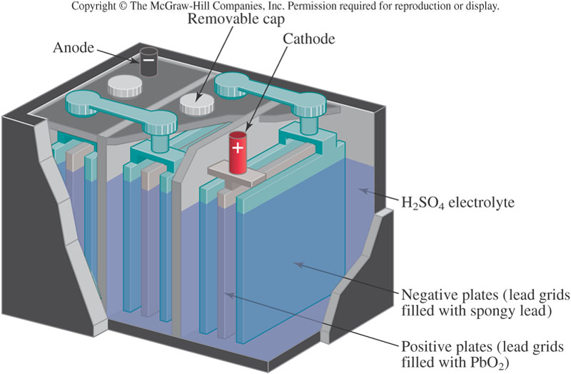
The Lead Storage Battery

Slide 23
Fuel Cells
Lecture Questions
  What is a fuel cell and how does it work?
  What is distributed generation?
  A fuel cell is basically a battery in which the reactants are continually supplied to the electrodes, and the products are continually removed.
    Much more efficient (2-3 times) than heat engines at generating electricity
    Most common type of fuel cells based on hydrogen (there are others)
  Fuel cells are scaleable
    Large ones can power homes or neighborhoods
    Small ones can be used in appliances
    Distributed generation is a decentralized power system consisting of hydrogen generators and fuel cells

Slide 24
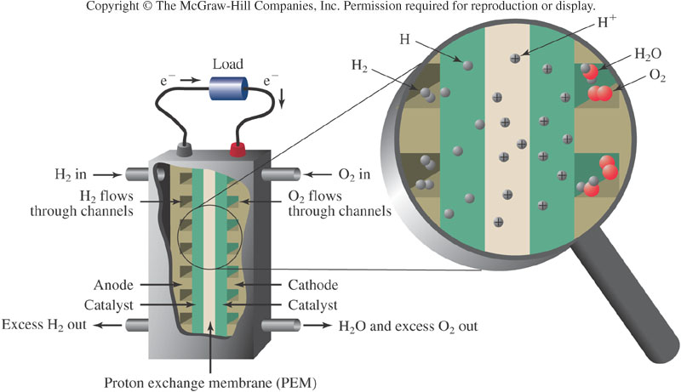
A Hydrogen Fuel Cell

Slide 25

Hydrogen Fuel Cells: Scalable

Slide 26
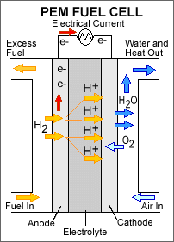
Polymer Electrolyte Fuel Cell

Slide 27
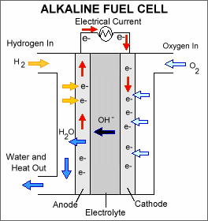
Alkaline Fuel Cell (AFC)

